Slide 1

Janaki Patel

Slide 2
Agenda
Overview
Problem Statement
Dataset Overview
Dashboard Overview
Primary Analysis
Secondary Analysis

Slide 3
Overview
Company Overview
LioCinema is a leading telecommunications provider in India, offering digital connectivity solutions to millions of subscribers. Jotstar, one of India's most prominent streaming platforms, is known for its vast and diverse content library. The proposed merger between Lio and Jotstar aims to create a powerhouse in the Indian OTT landscape by integrating LioCinema’s massive subscriber base with Jotstar’s content offerings. Market Position
LioCinema has a strong foothold in the Indian digital ecosystem, leveraging Lio’s telecom infrastructure to provide bundled streaming services. Jotstar, on the other hand, is a dominant player in the OTT market, competing with global and domestic streaming giants. By merging, Lio-Jotstar aims to challenge existing leaders, offering a comprehensive and data-driven content strategy tailored to Indian audiences.

Slide 4
Problem Statement
Lio’s management seeks an in-depth analysis of platform performance from January to November 2024 to refine content strategy, enhance subscriber retention, and establish Lio-Jotstar as India’s leading OTT platform. My role is to evaluate user engagement, content consumption, and subscriber behavior by integrating data, identifying trends, and assessing platform performance. The insights gained will optimize content offerings, improve user experience, and reduce churn, ensuring a successful merger.
Key Insights Addressed:
Content Library Analysis
Subscriber Insights
Inactivity Analysis
Upgrade Patterns
Downgrade Patterns
Content Consumption Behavior

Slide 5
Dataset Overview
Contents : Information about the content available on the both platform, enabling analysis of content diversity, genre popularity, and runtime patterns.
Subscribers: Information about demographic and subscription details , enabling insights into subscriber acquisition, upgrades, downgrades, and inactivity patterns.
Content_consumption: User-level content consumption data, enabling analysis of total watch time, device preferences, and engagement trends.

Slide 6
Dashboard Overview

Slide 7
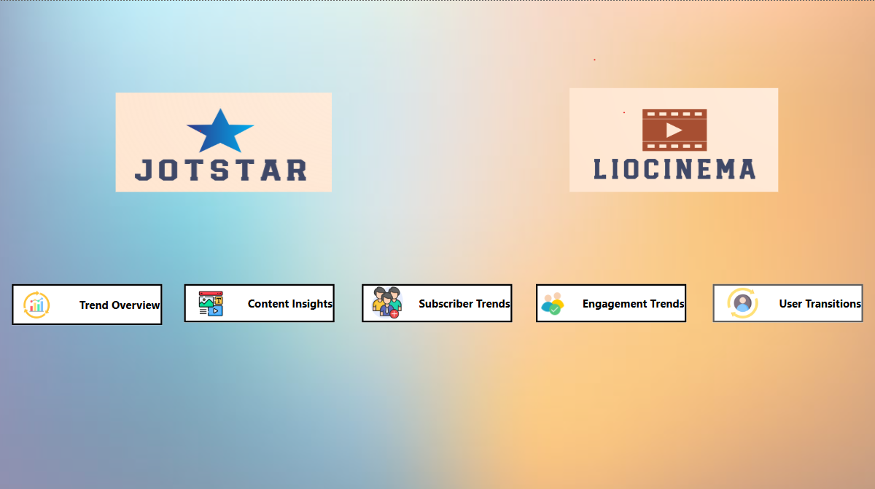

Slide 8
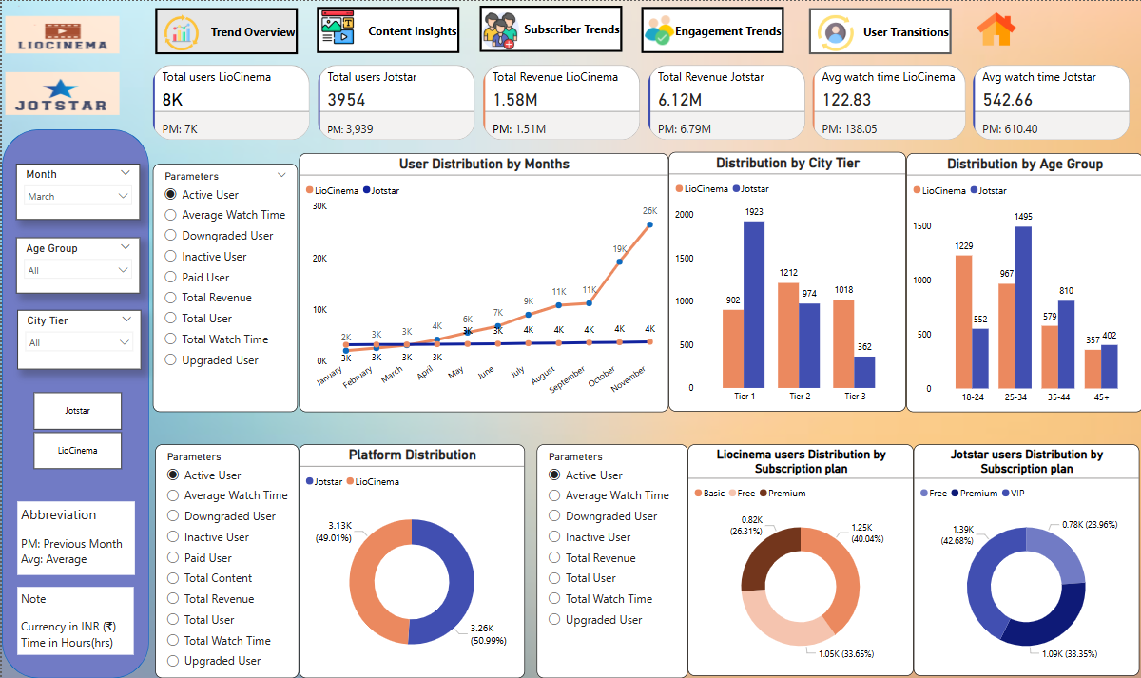

Slide 9
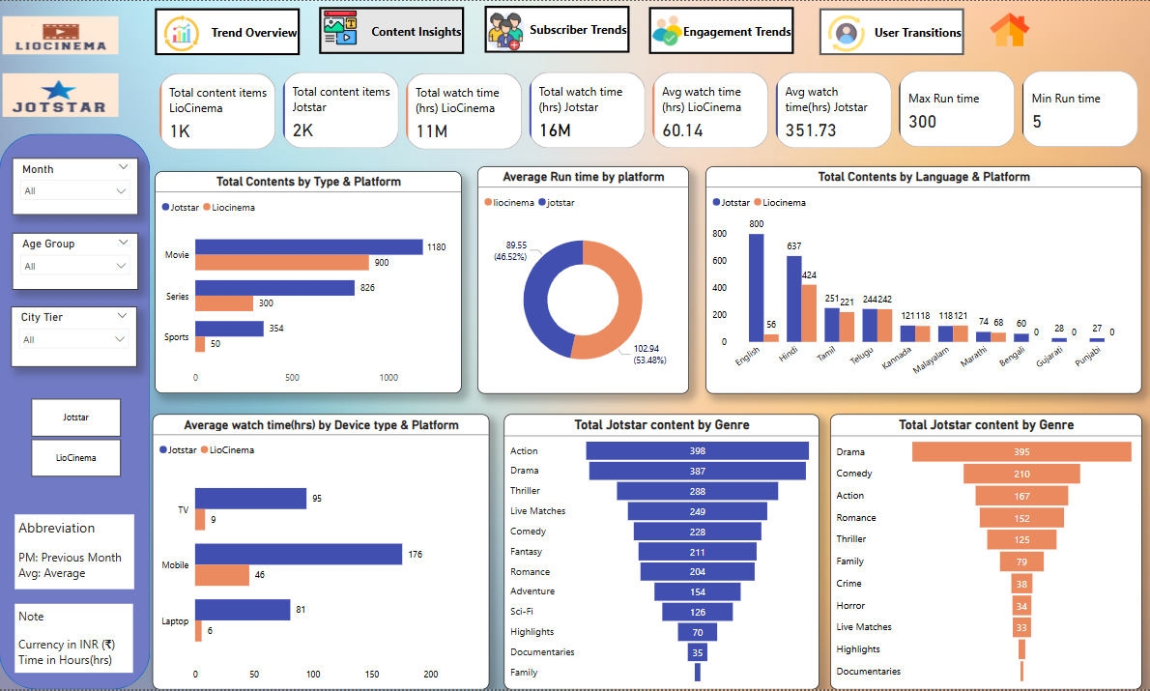
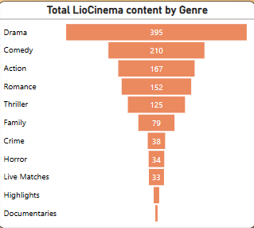

Slide 10
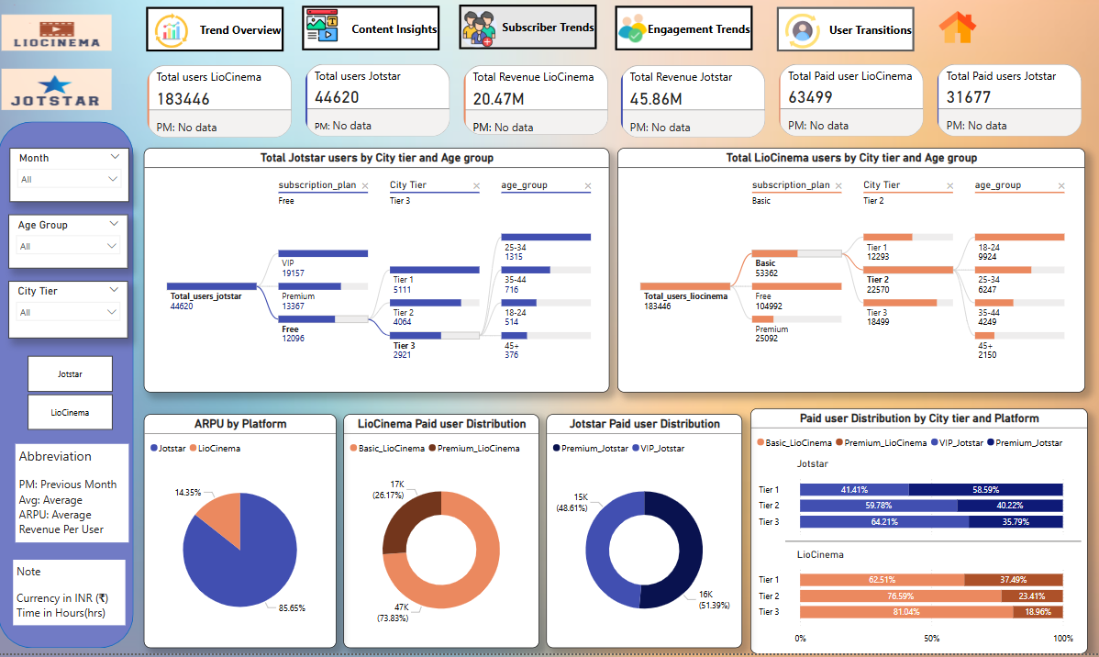

Slide 11
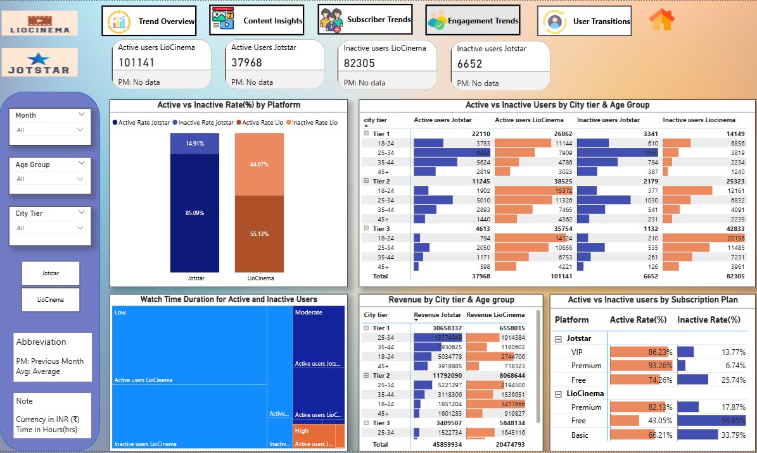

Slide 12
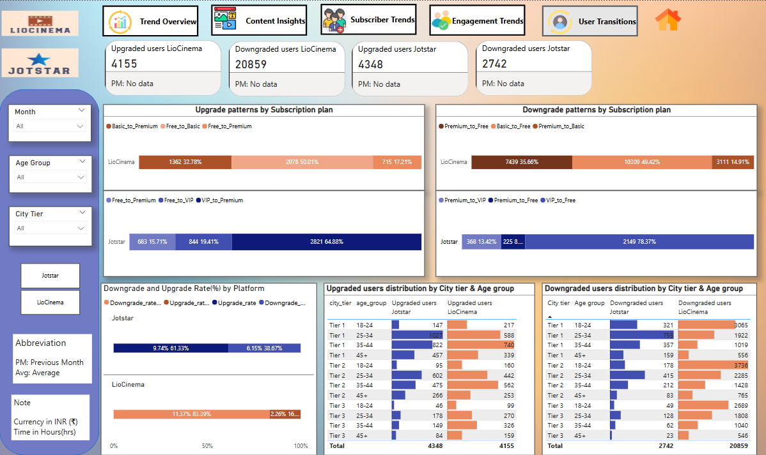

Slide 13
Primary Analysis

Slide 14
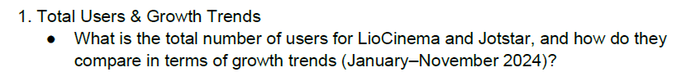
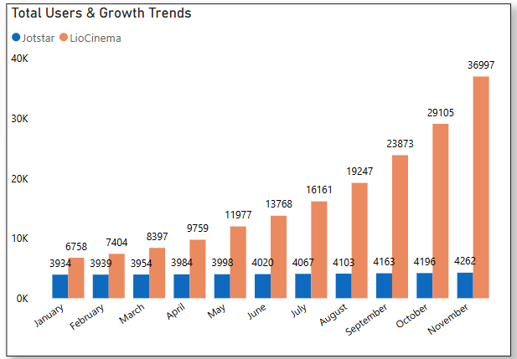
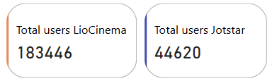
Insights:
LioCinema has significantly higher total users compared to Jotstar, showing exponential growth.
Jotstar has relatively stagnant growth, indicating limited user acquisition.
LioCinema's growth rate accelerates 4x faster than Jotstar in terms of user acquisition.

Slide 15
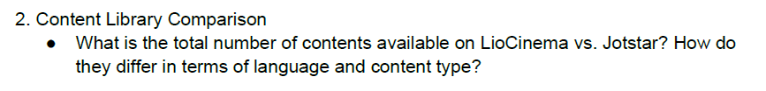
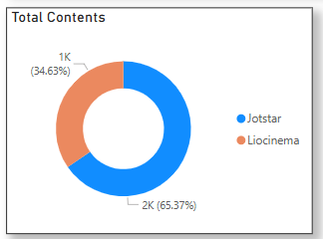
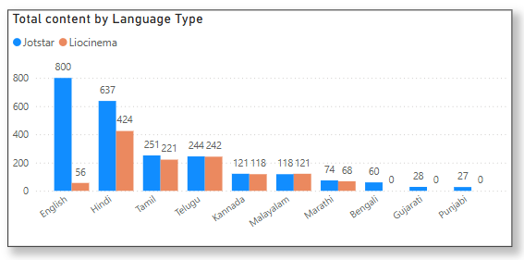
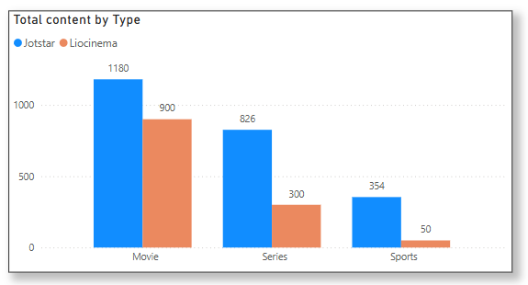
Insights:
Content Diversity: Jotstar has a larger and more diverse content library (2360 items) compared to LioCinema (1250 items)
Language Focus: LioCinema has a higher proportion of Hindi content while Jotstar leads in English, Hindi and regional languages like Tamil and Telugu.
Content Type: Jotstar offers more movies and series , while LioCinema focuses heavily on movies but lacks in sports content.

Slide 16
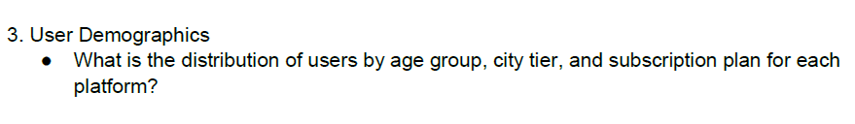
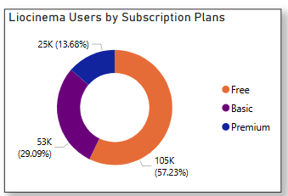
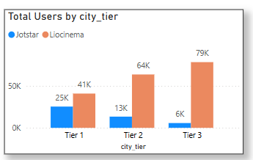
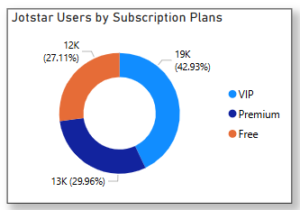
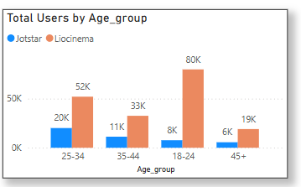
Insights:
User Demographics: LioCinema dominates in younger age groups (18-24 and 25-34) and Tier 2/Tier 3 cities, while Jotstar is more concentrated in Tier 1 cities.
Subscription Plans: LioCinema has a large free user base (104,992), while Jotstar has a higher proportion of paid users (Premium and VIP plans).

Slide 17
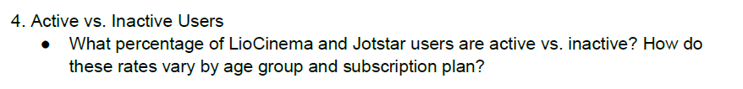
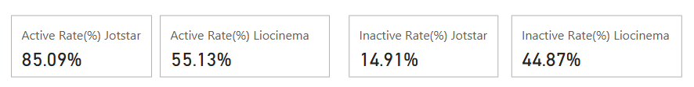
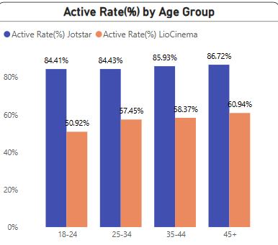
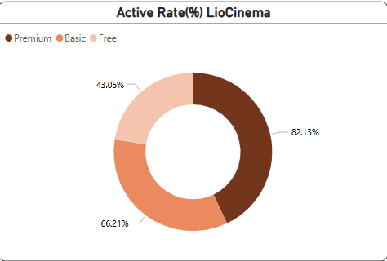
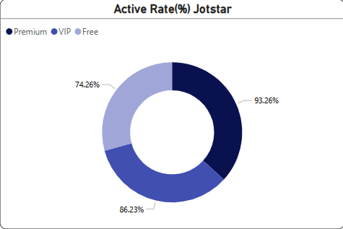
Active Rate

Slide 18
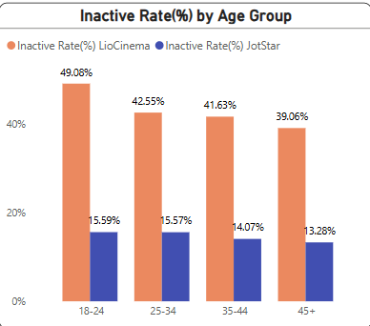
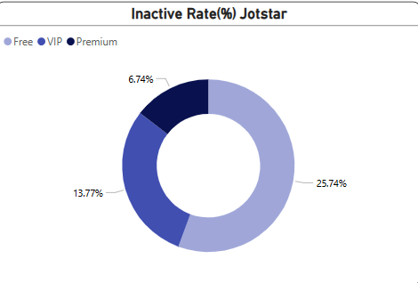
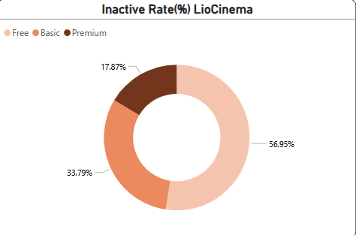
Inactive Rate
Insights:
Jotstar has a significantly higher active user rate compared to Liocinema.
Premium Users are Active in both platform.
Older age groups (45+) are more active on Jotstar compared to Liocinema , while younger users (18-24) show the lowest activity on Liocinema .

Slide 19
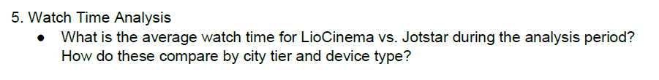
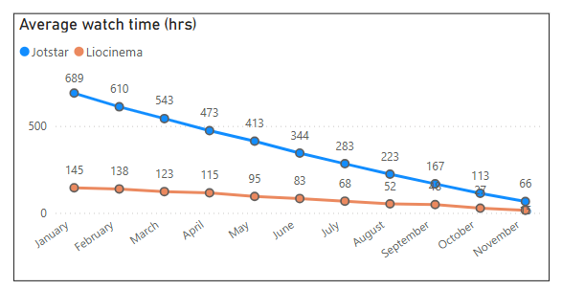
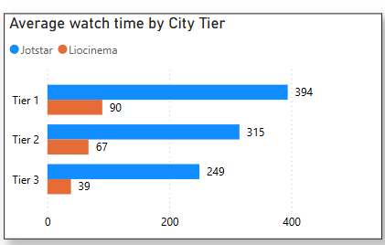
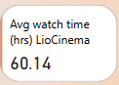
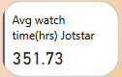
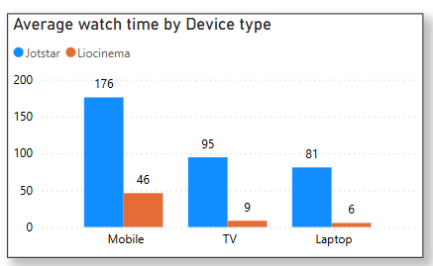
Insights:
Jotstar has a significantly higher average watch time (351.73) compared to Liocinema (60.14) across all months, devices, and city tiers.
Watch time declines steadily over the year for both platforms
Mobile devices dominate watch time for both platforms, while TVs and laptops show much lower engagement.
Tier 1 cities have the highest watch time, with engagement decreasing in lower-tier cities.

Slide 20
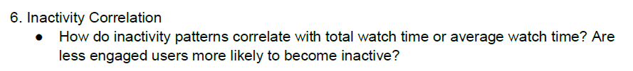
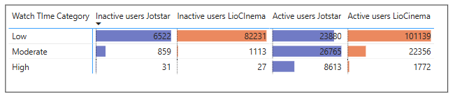
Insights:
Inactivity is highly correlated with Low watch time, as 90% of inactive users on both platforms fall into this category.
Users with Moderate or High watch time are far less likely to become inactive, indicating that higher engagement reduces churn.

Slide 21
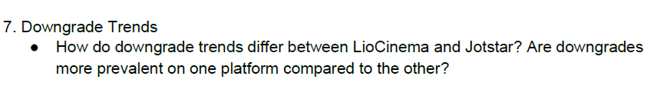
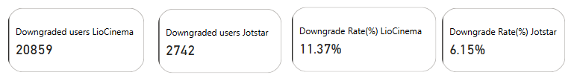
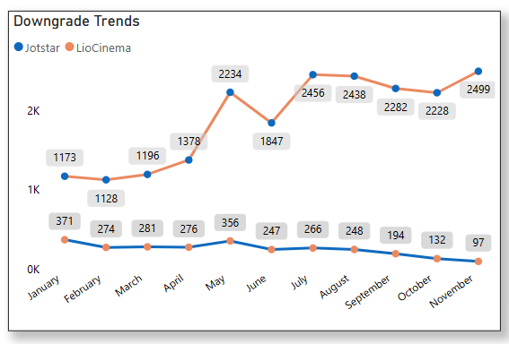
Insights:
Jot's downgrades show a steady decline from January to November, with a significant drop starting in September, indicating potential improvements or reduced dissatisfaction over time.
Both platforms see a spike in downgrades in May, possibly due to seasonal trends or policy changes.

Slide 22
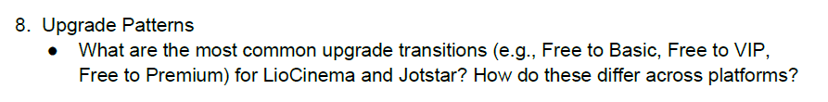
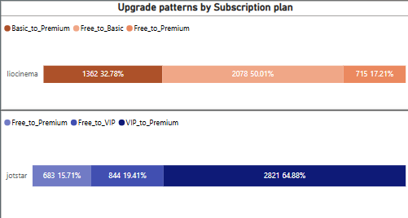
Insights:
LioCinema: Free to Basic (2,078) being the most common, while Free to Premium (715) is the least frequent.
Jotstar: VIP to Premium (282) as the top transition.
Platform Comparison: LioCinema users prioritize cost-effective gradual upgrades, whereas Jotstar users show a stronger preference for premium features.

Slide 23
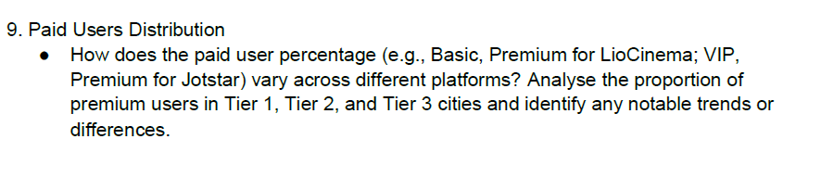
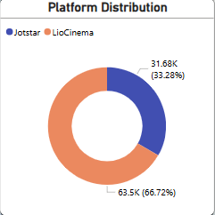
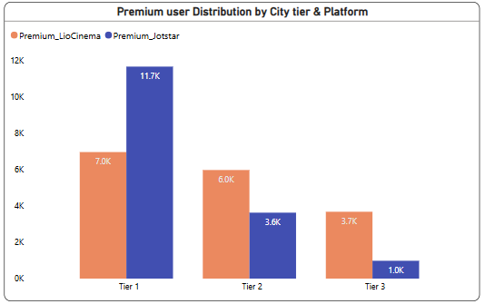
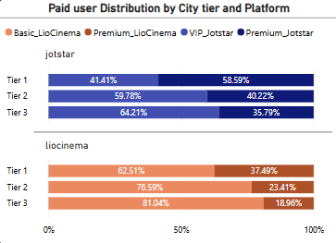
Insights:
Jotstar leads in Tier 1 Premium subscriptions indicating a stronger appeal for premium content in urban areas
User engagement drops sharply from Tier 1 to Tier 3
Liocinema holds a larger share of total paid users compared to Jotstar.

Slide 24
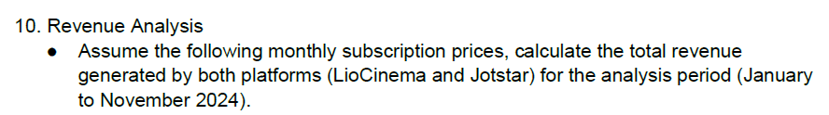
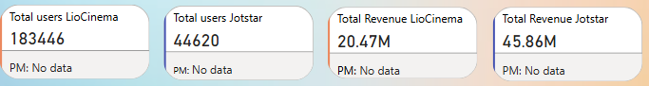
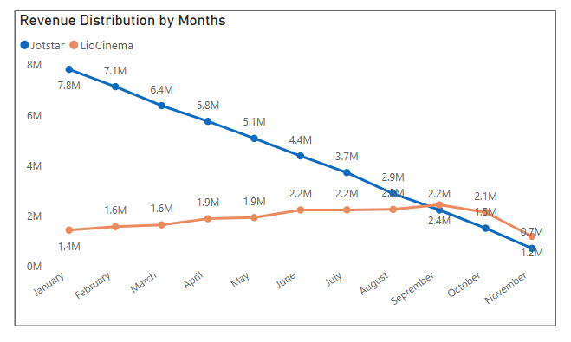
Insights:
Jotstar leads in total revenue compared to LioCinema’s
Jotstar’s revenue declines steadily,
LioCinema shows more stability, peaking in September before a drop.

Slide 25
Secondary Analysis

Slide 26
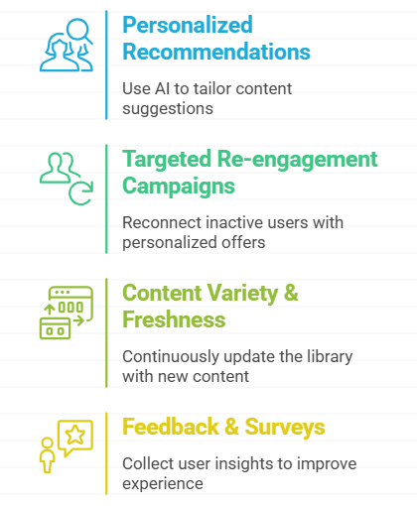
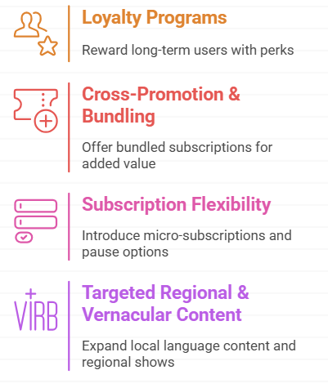
What strategies can the merged platform implement to increase engagement among inactive users and convert them into active users?

Slide 27
What type of brand campaigns should the merged platform launch to establish itself as the go-to OTT platform in India?
Lio-Jotstar: The Ultimate Entertainment Destination
"One Platform, Endless Stories": "From Bollywood to Tollywood, thrillers to rom-coms—your favorite stories, all in one place."
"Your Stories, Your Platform": "Celebrating the heart of India with stories that feel like home."
"Binge Without Borders": "Stream seamlessly, anytime, anywhere—no limits, no buffering."
"Exclusively Yours": "Blockbuster originals and early releases you won’t find anywhere else."
"Family Time, Anytime": "From kids to grandparents, there’s something for everyone to enjoy together."
"Switch to Better": "Why settle for less? Upgrade to ad-free, affordable, and premium entertainment."
Regional and Cultural Campaigns: "Your language, your culture, your stories—made just for you."
"Watch and Win": "Binge your favorites, win exciting rewards—entertainment with a bonus!"
Celebrity-Driven Campaigns: "Your stars, your platform—join the entertainment revolution."
"Stream Smarter, Not Harder": "Personalized, seamless, and easy—entertainment tailored to you."

Slide 28
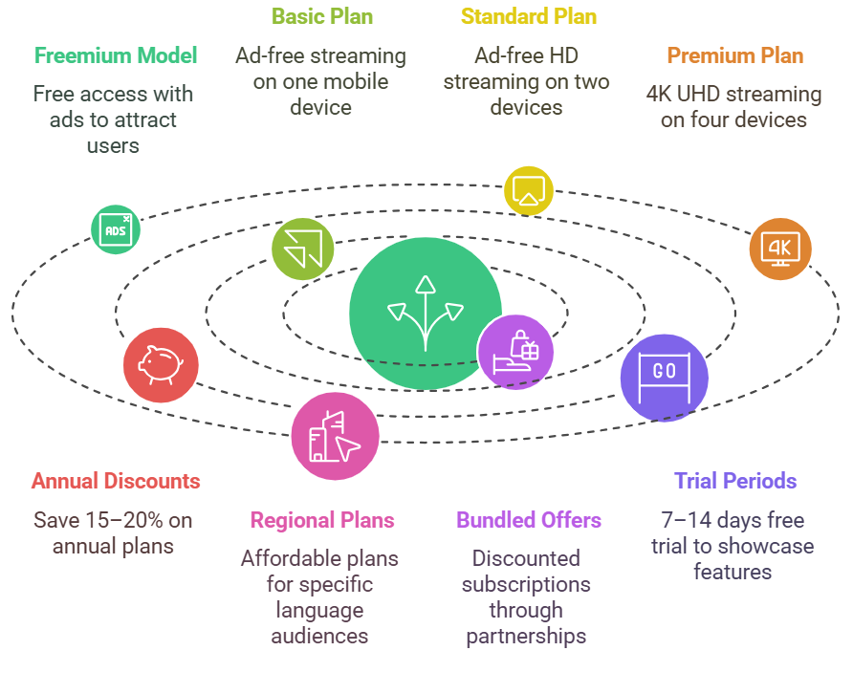
How should the merged platform price its subscription plans to compete effectively while maintaining profitability?

Slide 29


How can the platform leverage partnerships with telecom companies to expand its subscriber base?

Slide 30

What role can AI and machine learning play in personalizing the user experience and improving content discovery?

Slide 31




Who should be the brand ambassador for the newly merged OTT platform (LioCinema-Jotstar) to effectively represent its identity and attract a diverse audience?
Shah Rukh Khan – The Evergreen Global Icon Bollywood’s biggest superstar with mass appeal across India and international audiences.
Allu Arjun– South + Pan-India Mass Appeal A South Indian megastar turned national sensation, perfect for engaging regional and Bollywood fans.
Virat Kohli – Sports + Youth Connection India’s cricketing icon, resonating with sports lovers and young audiences alike.
Deepika Padukone:
A global icon with a strong presence in Bollywood and international projects.

Slide 32


